Slide 1

Movie Recommendation System.
Using Machine Learning With Python
Group Members →
Anindya Kumar Ghosh (32201220090) Chiranjib Ghosh (32201220072) Irfan Ahmad (32201220055) K. Janvee Rao (32201220029) Shreyasi Das (32201220082)
Asansol Engineering College
*Please view this presentation using Slideshow

Slide 2
Table of Contents
1
2
3
4
Acknowledgement
Project Objective
A special thanks to teachers and group members
A brief introduction to what our project is about
Model Used
Libraries Used
Brief description about the models used
Brief description about the libraries used
5
The Dataset
6
Data Visualization
A tour of the different visualizations provide in our python code
A tour of the different visualizations provide in our python code
7
Code Explanation
8
Thank You
Clear explanation on how our code works
Ending Page

Slide 3
“We take this opportunity to express our profound gratitude and deep regards to our guide, Assistant Prof. Subhash Chandra Nath and our group members for their exemplary guidance throughout the course of this project.”

Slide 4
1
Project Objective.
Our MovieLens dataset contains about 20,000 records of Hollywood movies released since 1990
For this project we are going to take the genre of the movie into consideration
The user may enter the name of any Hollywood movie present in the dataset
Let’s Go Through The Objectives →
The output will recommend top 10 similar types of movies based on the same genre by using machine learning algorithms

Slide 5

Model Used.
3 |
Bag-Of-Words Model (BoW)
It represents text as numerical features for machine learning:
1. It tokenizes text into individual words or tokens.
2. It creates a vocabulary of unique words.
3. It extracts features by counting the presence or absence of words in documents.
4. It represents each document as a numerical vector based on word occurrences.
5. It is a simple but effective approach for text representation and analysis.

Slide 6
1
2
3
Libraries Used.
4 |
NumPy
Pandas
Matplotlib
Python library for numerical computing with powerful array objects and mathematical functions.
Python library for data manipulation and analysis, providing data structures like Data-Frames.
Widely-used Python library for creating static, animated, and interactive visualizations.

Slide 7
4
5
More Libraries Used.
4 |
Seaborn
Sklearn
Python data visualization library based on matplotlib, offering high-level data visualization functions.
Python's machine learning library with diverse algorithms for classification, regression, clustering, and more. Widely used for data analysis and modeling

Slide 8

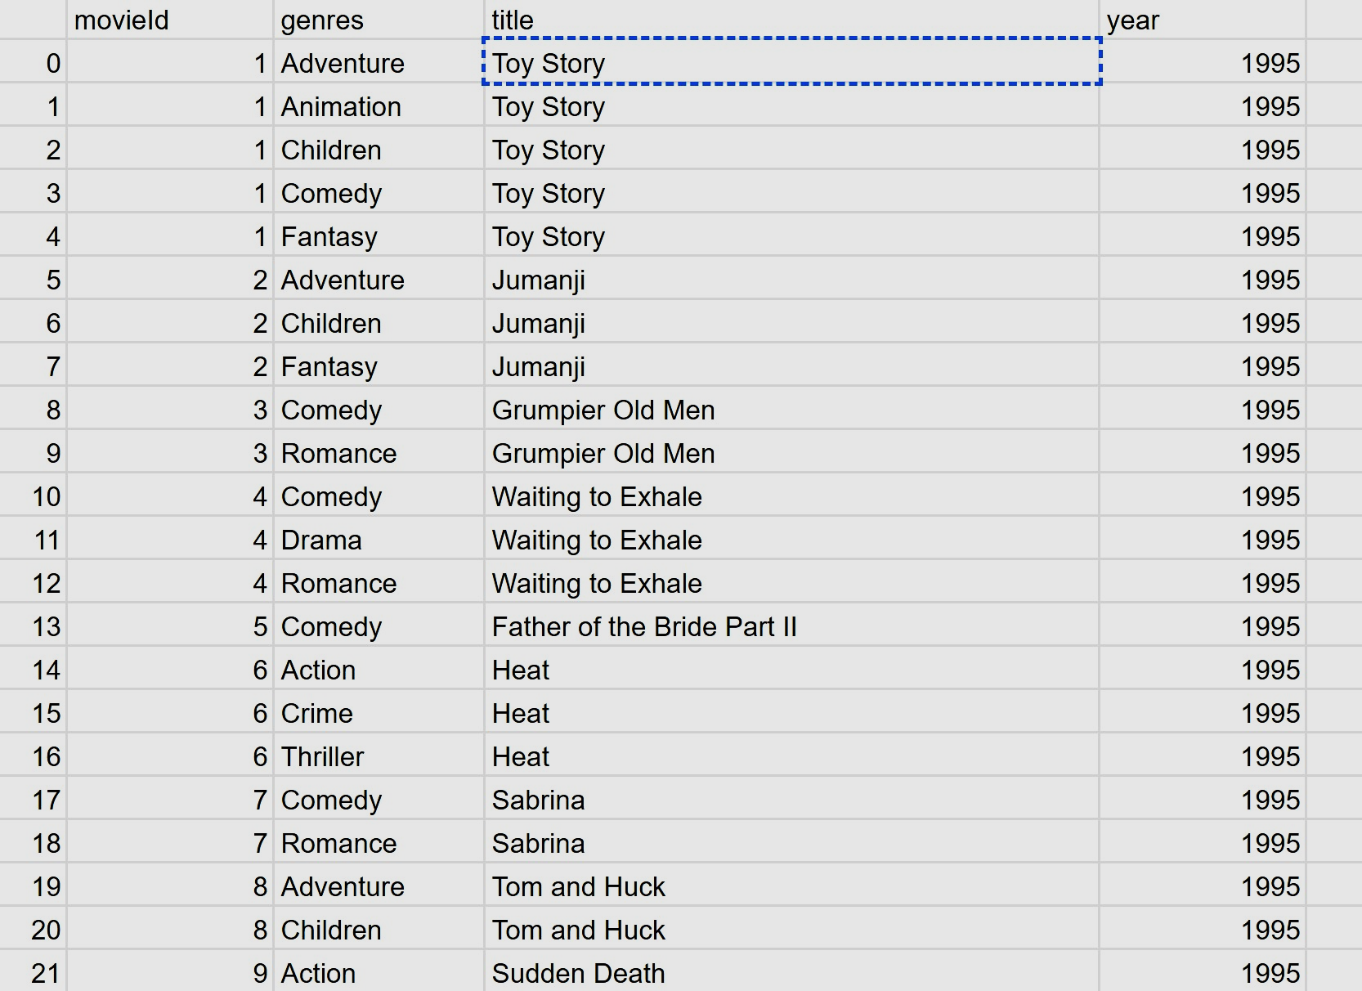
The Dataset #1.
We have used four datasets in our project → mv_yr.csv, ratings.csv, tags.csv and links.csv.
The snippet in the right is that of movies.csv. It contains the columns – movieID, genres, title and year of release.
Genres are an important factor here because this column will be used to predict the top 10 movies.
mv_yr.csv (Movies dataset)

Slide 9
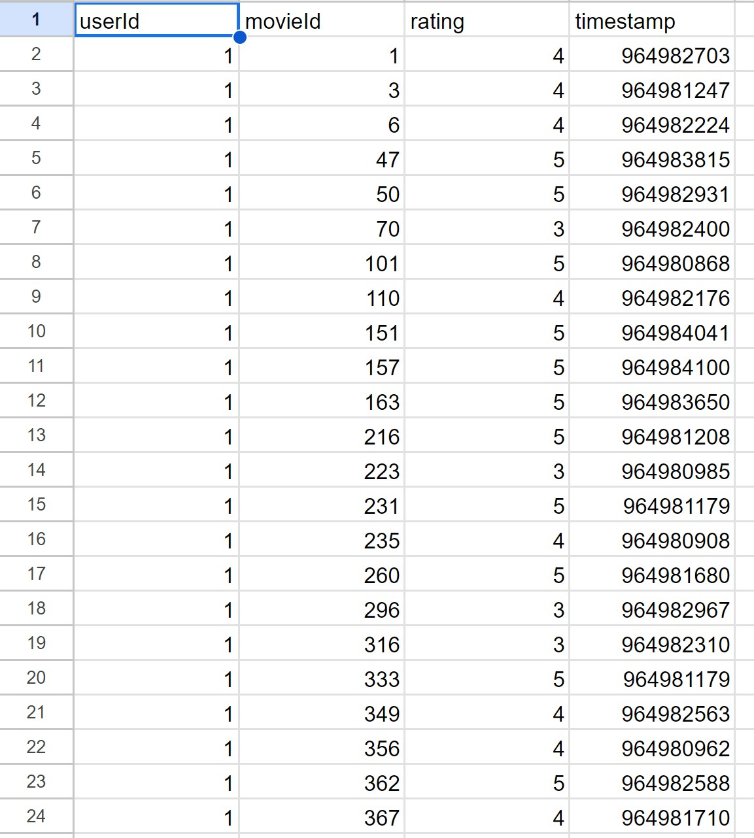
The Dataset #2.
We have used four datasets in our project → movies.csv , tags.csv, links.csv & ratings.csv.
The snippet in the right is that of ratings.csv. It contains the columns – userID, movieID, rating, timestamp.
Rating is an important factor here because this column will be used to predict the top 10 movies along with genres.
ratings.csv (ratings dataset)

Slide 10
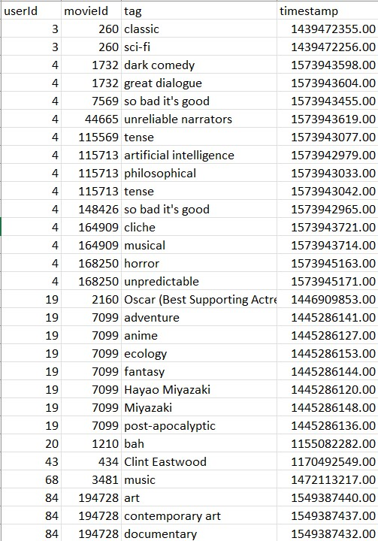
The Dataset #3.
We have used four datasets in our project → mv_yr.csv, ratings.csv, tags.csv and links.csv.
The snippet in the right is that of tags.csv. It contains the columns – userID, movieID, tag, timestamp.
Tag is an important factor here because this column will be used to predict the top 10 movies along with genres.
tags.csv (ratings dataset)

Slide 11
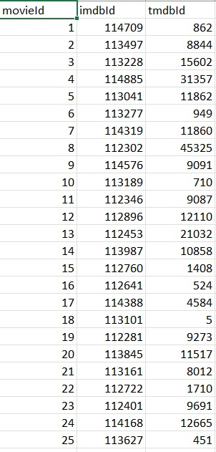
The Dataset #4.
We have used four datasets in our project → mv_yr.csv, ratings.csv, tags.csv and links.csv.
The snippet in the right is that of links.csv. It contains the columns – userID, movieID, rating, timestamp.
Imdb & Tmdb ID are an important factor here because these columns will be used to predict the top 10 movies along with genres.
links.csv (ratings dataset)

Slide 12






Data Visualization.
Matplotlib's bar graphs visually represent categorical data using bars of varying heights
Using matplotlib and seaborn, in this project, we have created a variety of plots, including line plots, bar plots, scatter plots, histograms, and heatmaps etc., to explore patterns, relationships, and distributions within the data. Additionally, we have utilized the customization options provided by matplotlib and seaborn to enhance the aesthetics, adjust plot styles, and incorporate color palettes, making our visualizations more engaging and professional-looking.
Visualizing correlations and providing a compact representation of numeric variable distribution.
Pie charts display proportions of different categories within a whole using slices of a circle.

Slide 13
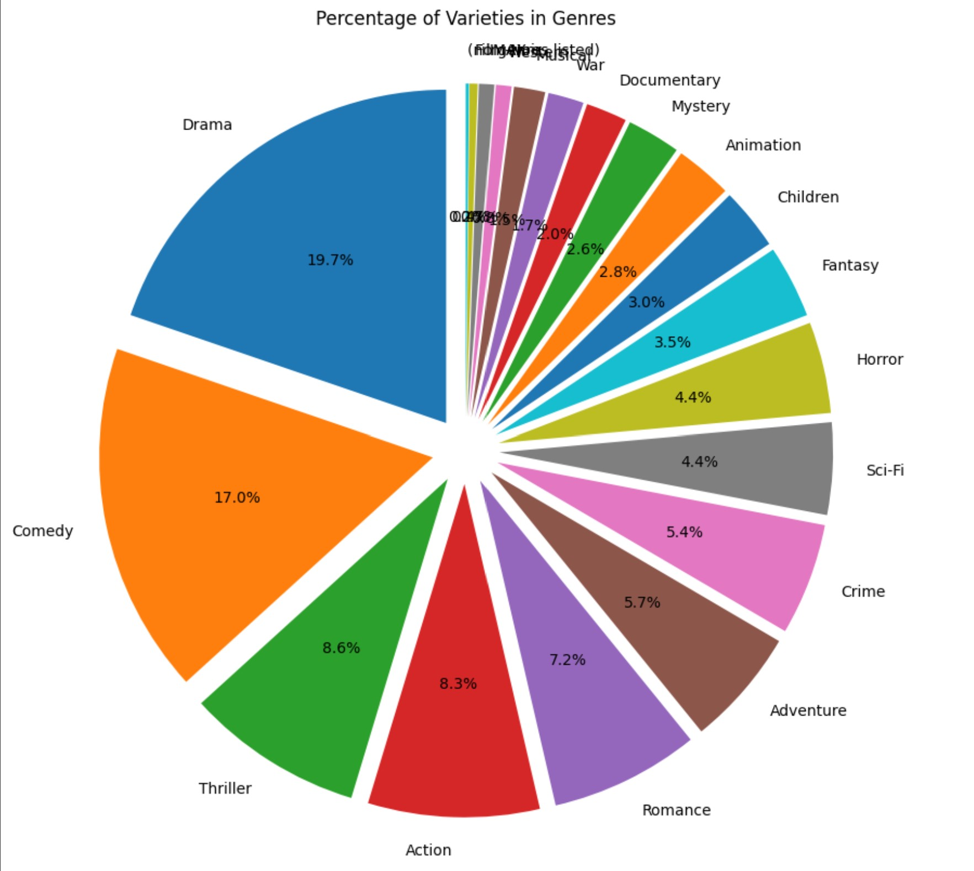
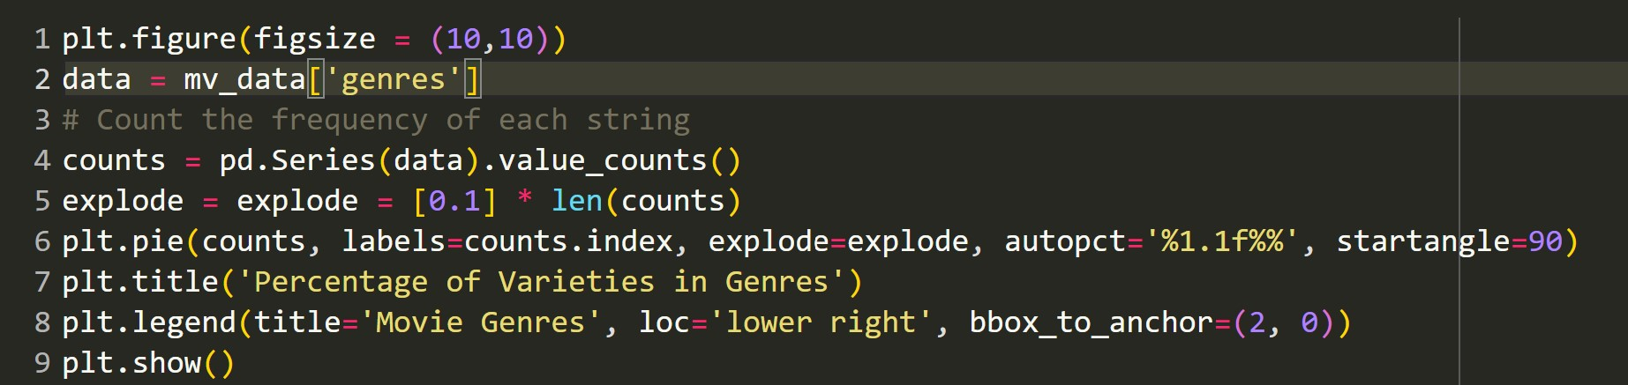
Matplotlib PieChart.
Code For Pie Chart →
The given code snippet is using `plt.figure(figsize=(10,10))` to set the figure size, `pd.Series(data).value_counts()` to count the frequency of each string in the 'genres' column of the 'mv_data' dataset, and `plt.pie` to create a pie chart using the counts. The pie chart includes exploded segments, percentage labels, a title, and a legend with the movie genres. Finally, `plt.show()` is used to display the chart.
Pie-Chart Diagram

Slide 14
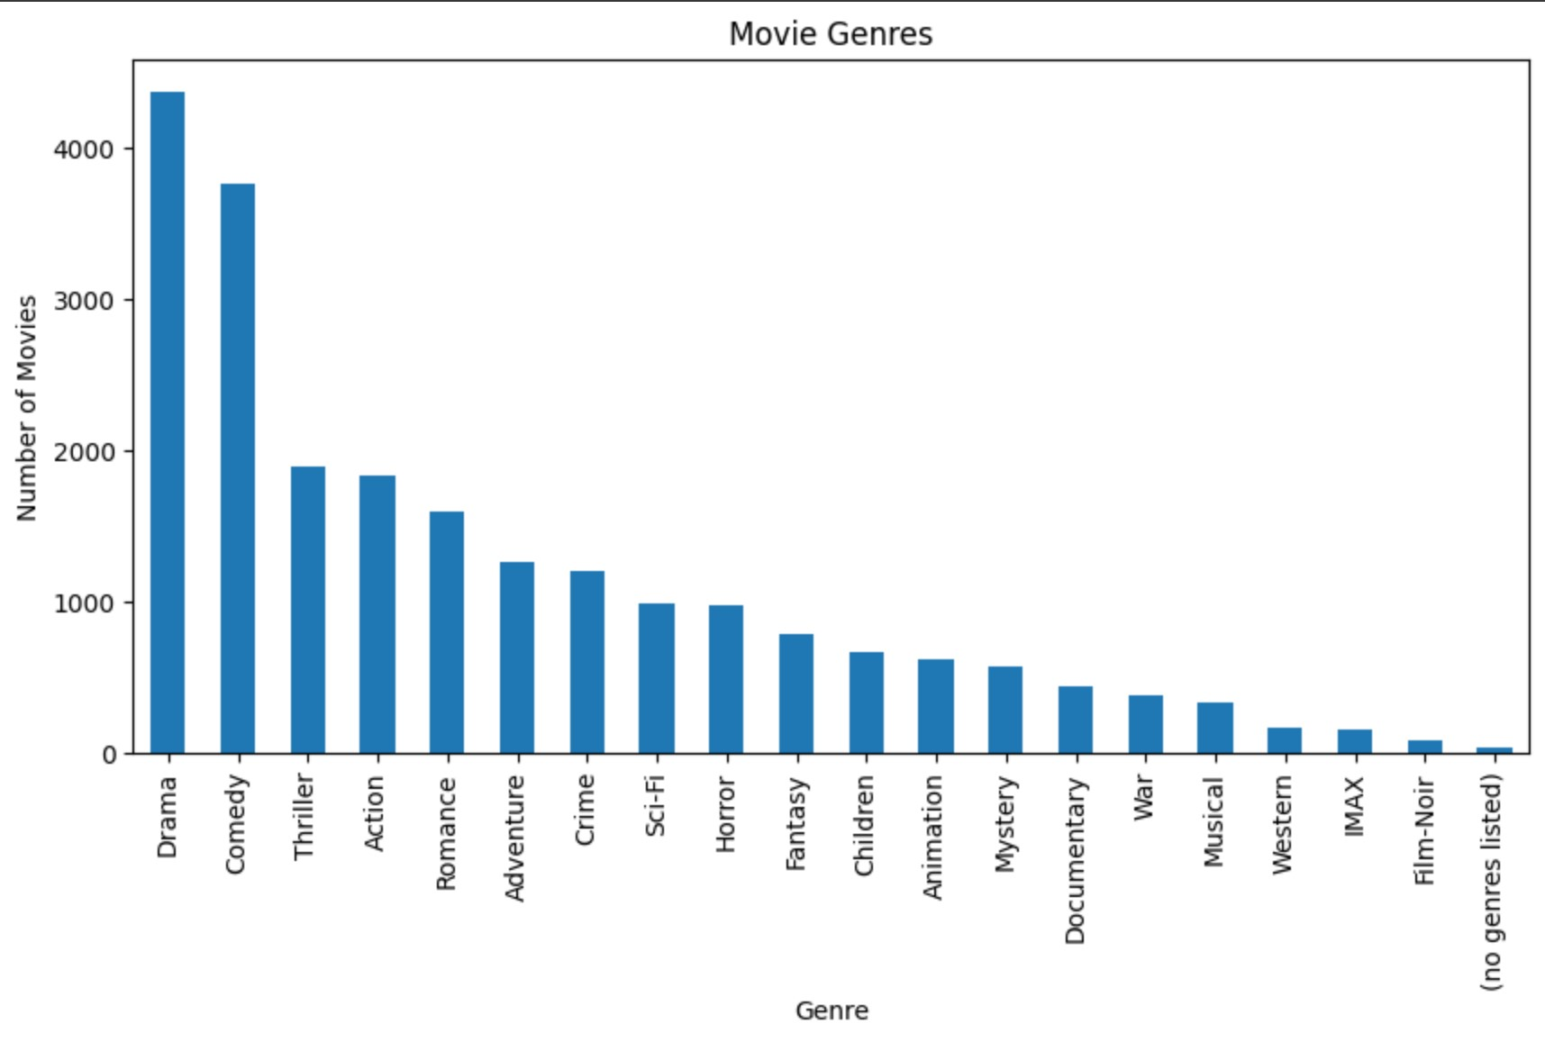
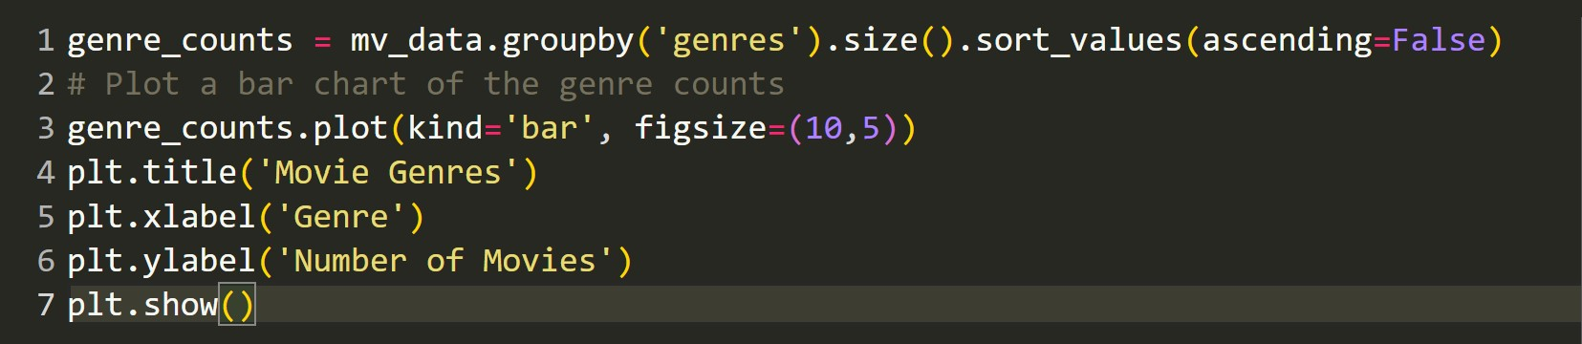
Matplotlib BarGraph.
Code For Bar Graph →
The provided code snippet is calculating the count of movies in each genre using `mv_data.groupby('genres').size().sort_values(ascending=False)`. It then uses `genre_counts.plot(kind='bar', figsize=(10,5))` to create a bar chart to visualize the genre counts. Additional steps include adding a title to the plot using `plt.title('Movie Genres')`, labeling the x-axis as 'Genre' using `plt.xlabel('Genre')`, and labeling the y-axis as 'Number of Movies' using `plt.ylabel('Number of Movies')`. Finally, `plt.show()` is used to display the bar chart.
Bar-Graph Diagram

Slide 15
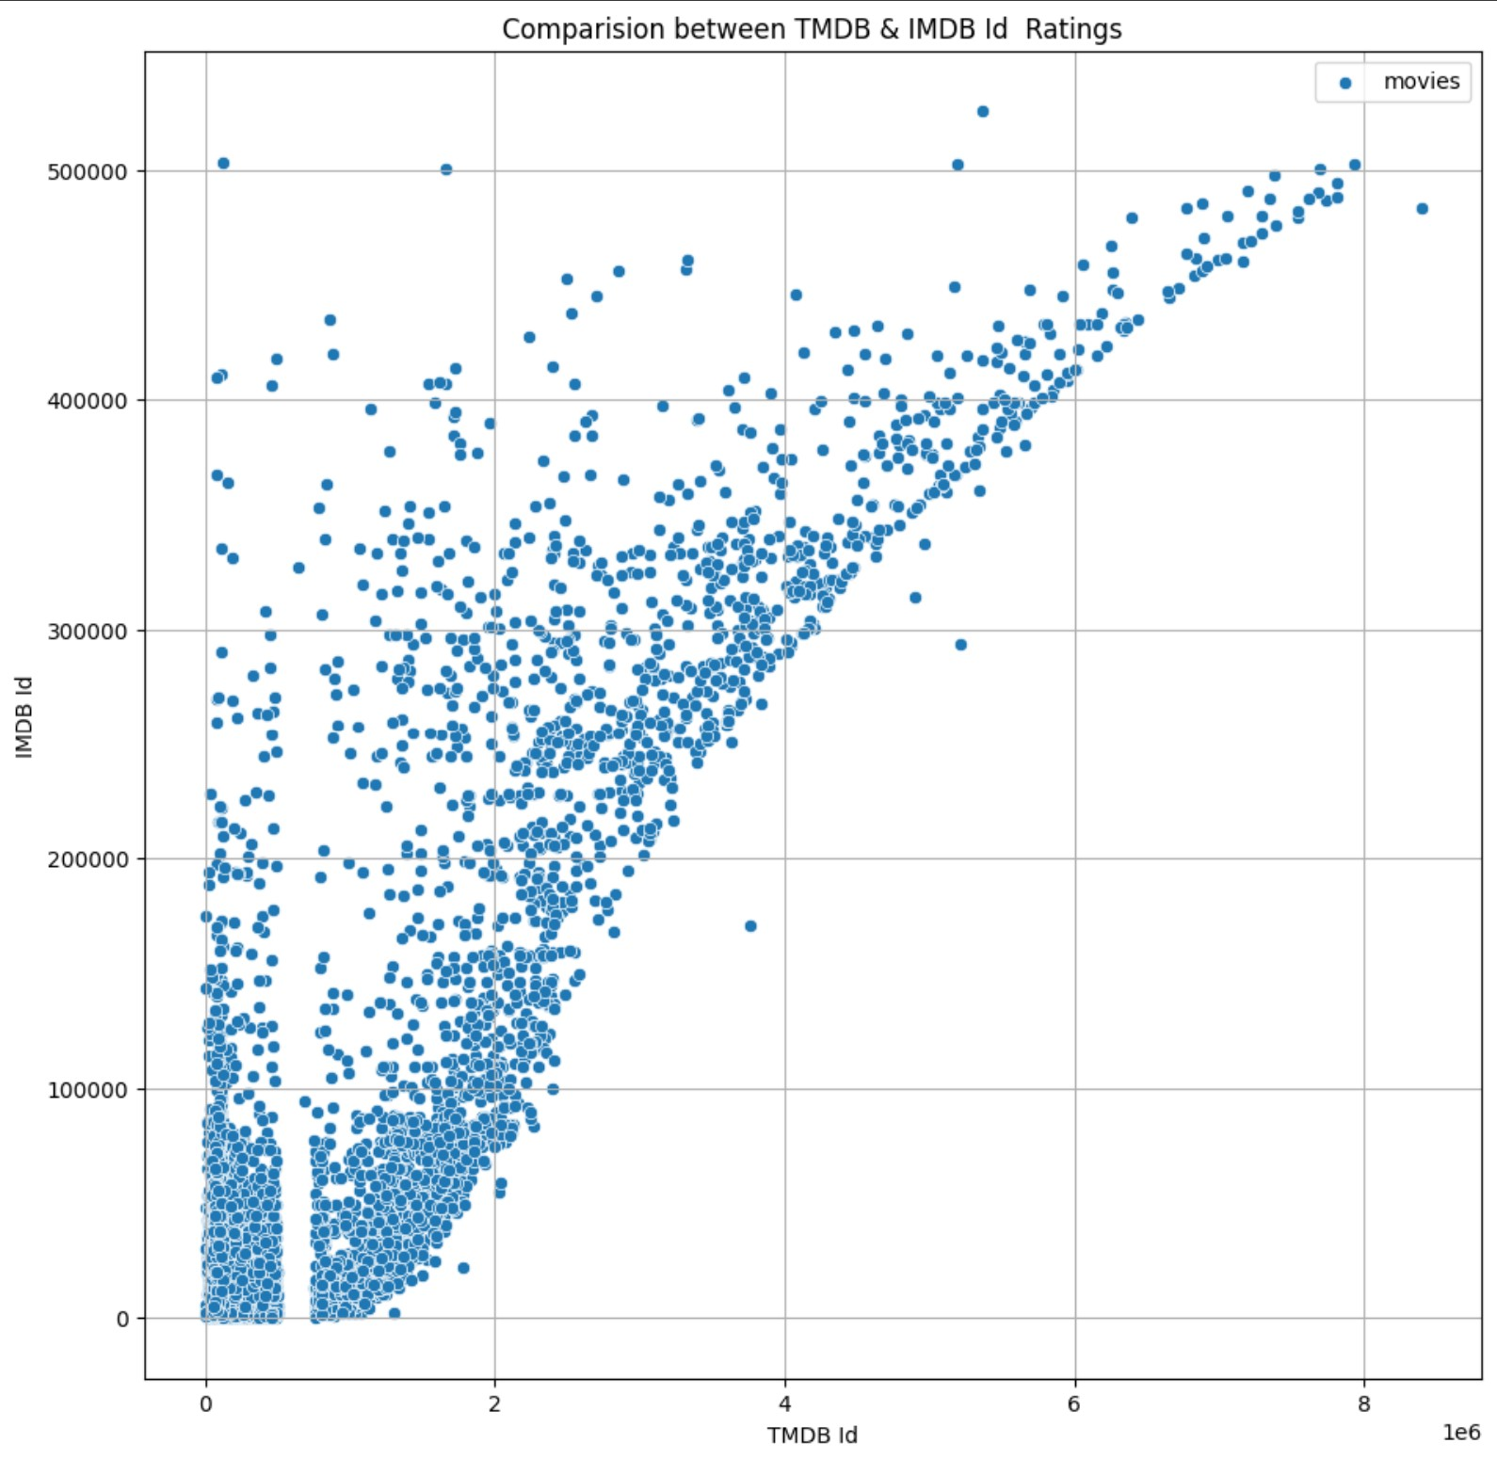
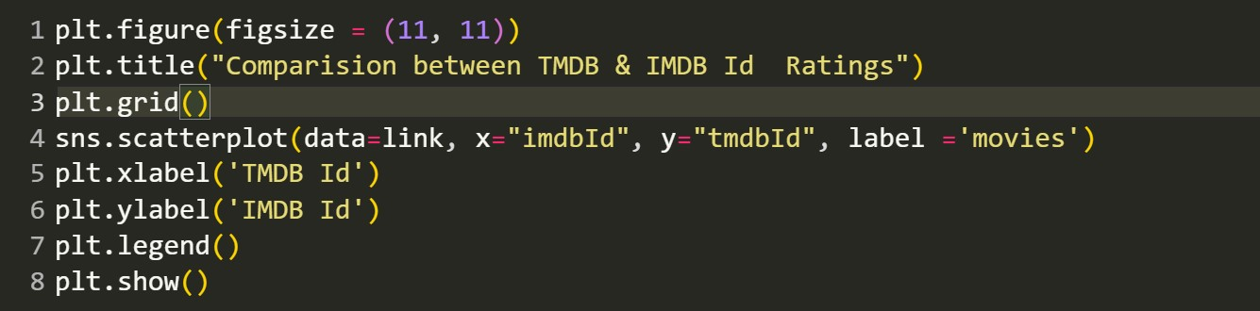
Seaborn Scatterplot.
Code For Bar Graph →
The given code snippet is creating a scatter plot using Seaborn (sns) and matplotlib.pyplot. It sets the figure size using `plt.figure(figsize=(11, 11))` and adds a title to the plot with `plt.title("Comparison between TMDB & IMDB Id Ratings")`. The plot is set to include a grid using `plt.grid()`. It uses `sns.scatterplot` to plot the data from the "link" dataset, with the x-axis representing "TMDB Id" and the y-axis representing "IMDB Id". The labels for the x-axis and y-axis are set using `plt.xlabel('TMDB Id')` and `plt.ylabel('IMDB Id')` respectively. The legend is added using `plt.legend()`. Finally, `plt.show()` is used to display the scatter plot.
Scatterlpot Diagram

Slide 16
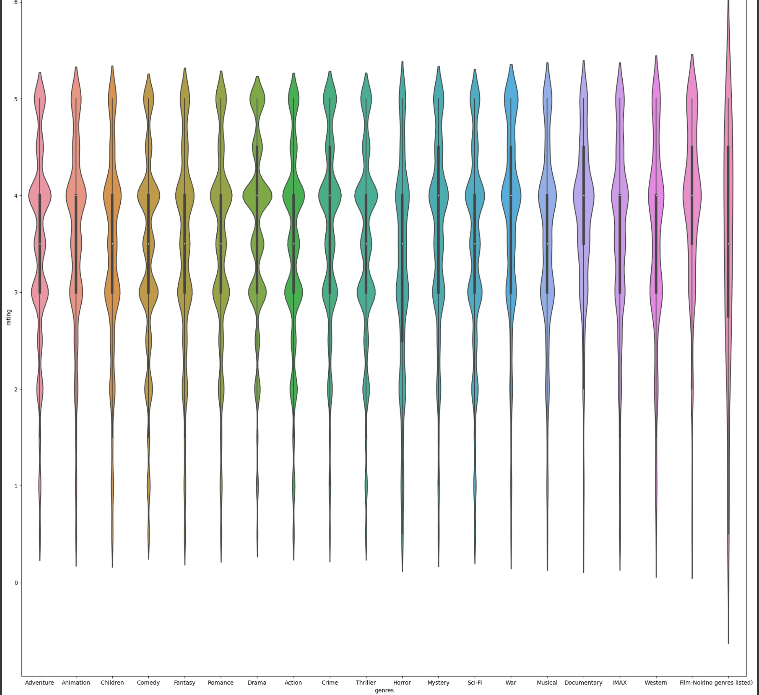
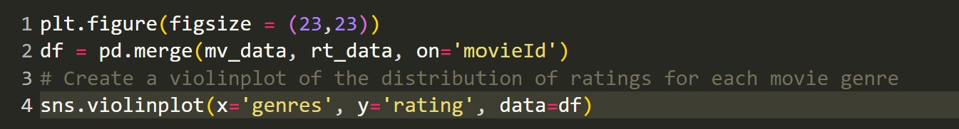
Seaborn Violinplot.
Code For Bar Graph →
The given code snippet creates a figure with a size of 23x23 using `plt.figure(figsize=(23,23))`. It then merges the 'mv_data' and 'rt_data' datasets on the 'movieId' column using `pd.merge(mv_data, rt_data, on='movieId')` and assigns the result to the variable 'df’ Next, it uses `sns.violinplot` to create a violin plot. The 'x' parameter is set to 'genres', representing the movie genres, and the 'y' parameter is set to 'rating', representing the ratings. The data for the plot is specified as 'df'.
Violinplot Diagram

Slide 17
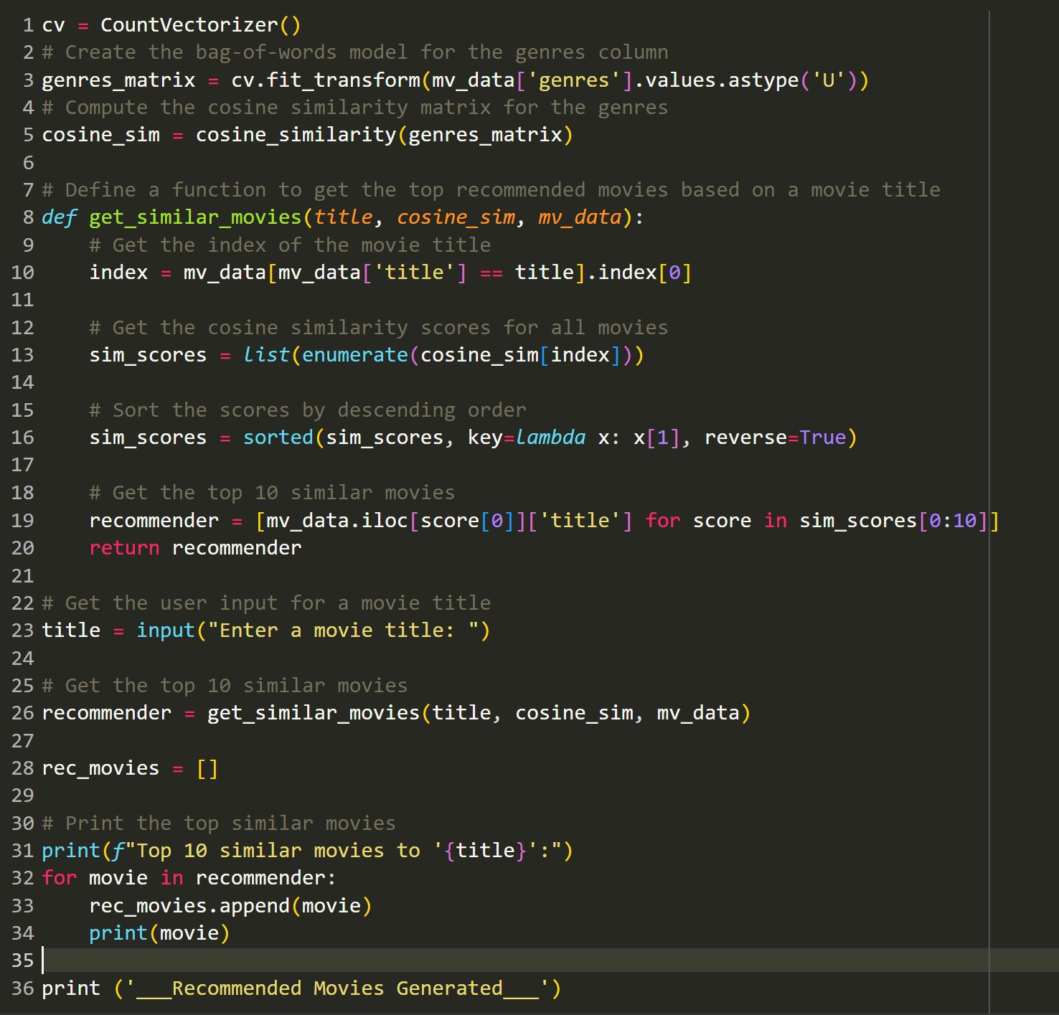
Recommendation Using Genres : Code Explanation #01.
In the given code snippet, the following steps are performed:
1. `cv = CountVectorizer()`: Initializes a CountVectorizer object, which is used to convert a collection of text documents into a matrix of token counts.
2. `genres_matrix =
cv.fit_transform(mv_data['genres'].values.astype('U'))`: Creates a bag-of-words model for the 'genres' column in the 'mv_data' dataset.

Slide 18
Code Explanation #02
3. `cosine_sim = cosine_similarity(genres_matrix)`: Computes the cosine similarity matrix for the genres. The cosine similarity measures the similarity between two vectors (in this case, the movie genre vectors) by calculating the cosine of the angle between them. The resulting matrix will have similarities between all pairs of movies based on their genre composition.
4. `def get_similar_movies(title, cosine_sim, mv_data)`: Defines a function that takes a movie title, cosine similarity matrix, and movie data as input. This function aims to find the top recommended movies based on similarity to the given movie title.
5. `index = mv_data[mv_data['title'] == title].index[0]`: Retrieves the index of the movie title provided by the user from the 'mv_data' dataset.
6. `sim_scores = list(enumerate(cosine_sim[index]))`: Retrieves the cosine similarity scores for all movies compared to the selected movie.
7. `sim_scores = sorted(sim_scores, key=lambda x: x[1], reverse=True)`: Sorts the similarity scores in descending order, with the most similar movies appearing at the top.

Slide 19
Code Explanation #03
8. `recommender = [mv_data.iloc[score[0]]['title'] for score in sim_scores[0:10]]`: Retrieves the titles of the top 10 similar movies based on the sorted similarity scores.
9. User input: Prompts the user to enter a movie title.
10. `recommender = get_similar_movies(title, cosine_sim, mv_data)`: Calls the `get_similar_movies` function to get the top 10 similar movies based on the user's input.
11. `rec_movies = []`: Initializes an empty list to store the recommended movies.
12. Printing recommended movies: Prints the top 10 similar movies to the given movie title.
13. `print ('___Recommended Movies Generated___')`: Prints a line indicating that the recommended movies have been generated.

Slide 20
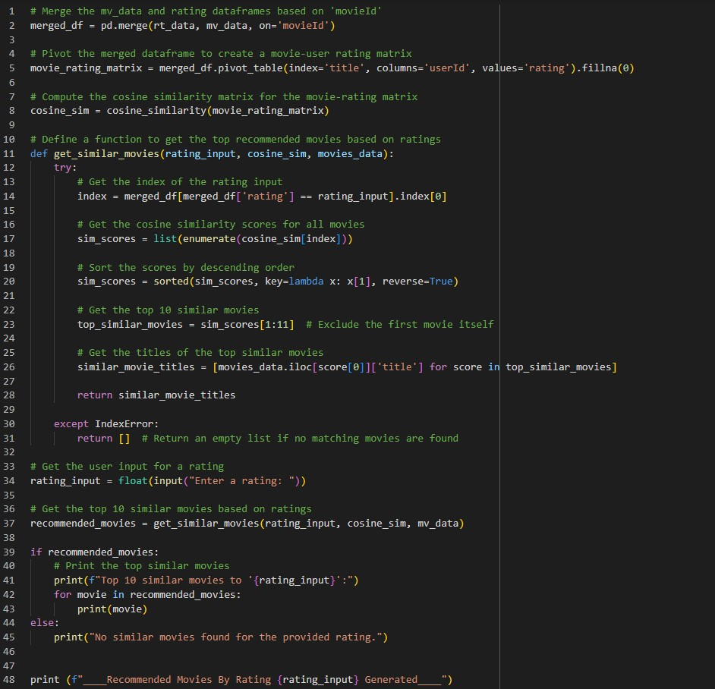
Recommendation Using Rating.
02

Slide 21
Thanks!
We had a great time working on this presentation. A huge thanks to all for their endless contribution towards this project.

